Slide 1
Group presentation
WANG Yue 13/2/2017

Slide 2
20 words:
Blandish (v.) to flatter, coax or persuade
Bleak (adj.) unsheltered and exposed to wind and cold; (adj.) cold, cutting and harsh; gloomy; (adj.) not hopeful
Chary (adj.) cautious or careful; (adj.) fastidious; sparing
Chimerical (adj.) fantasy, unreal or imaginary; (adj.) highly unrealistic
Controvert (v.) to be resistant to, to raise arguments against, to oppose
Dearth (n.) a lack, scarcity or inadequate supply
Deplete (v.) to reduce or eliminate in supply
Eminent (adj.) of high rank in station or quality; (adj.) outstanding in character or performance; (adj.) towering or standing above others
Equable (adj.) free from many changes or variations; (adj.) uniform
Expunge (v.) to erase or obliterate; (v.) to destroy
Forbearance (n.) tolerance in the face of challenge; (n.) patience
Gloaming (n.) the time of day that immediately follows the sunset
Hoodwink (v.) to deceive or trick
Impeach (v.) to accuse or bring to court, particularly a public official; (v.) to question or call into account
Incredulous (adj.) skeptical and disbelieving; (adj.) dubious
Judicious (adj.) using practical and proper judgment; demonstrating wisdom and/or good judgment
Laudatory (adj.) admiring; (adj.) expressing of praise
Minion (n.) a subordinate or underling
Modish (adj.) stylish, trendy
Ostensible (adj.) apparent and inconspicuous

Slide 3
Puzzle:
You have two jars, 50 red marbles and 50 blue marbles. You need to place all the marbles into the jars such that when you blindly pick one marble out of one jar, you maximize the chances that it will be red. When picking, you’ll first randomly pick a jar, and then randomly pick a marble out of that jar. You can arrange the marbles however you like, but each marble must be in a jar.

Slide 4
Puzzle Solution:
Say we put all the red marbles into JAR A and all the blue ones into JAR B. then our chances for picking a red one are:
1/2 chance we pick JAR A * 50/50 chance we pick a red marble 1/2 chance we pick JAR B * 0/50 chance we pick a red marble
You would try different combinations, such as 25 of each colored marble in a jar or putting all red marbles in one jar and all the blue in the other. You would still end up with a chance of 50%.
What if you put a single red marble in one jar and the rest of the marbles in the other jar? This way, you are guaranteed at least a 50% chance of getting a red marble (since one marble picked at random, doesn’t leave any room for choice). Now that you have 49 red marbles left in the other jar, you have a nearly even chance of picking a red marble (49 out of 99).
So the maximum probability will be : jar A : (1/2)*1 = 1/2 (selecting the jar A = 1/2, red marble from jar A = 1/1) jar B : (1/2)*(49/99) = 0 (selecting the jar B = 1/2, red marble from jar B = 49/99) Total probability = 74/99 (~3/4)

Slide 5
Unsupervised Representation Learning with Deep Convolutional Generative Adversarial Networks
Slides created and presented by: Jeremy Kawahara (Aug 25, 2016)
Check out the online post and original slides here: http://kawahara.ca/deep-convolutional-generative-adversarial-nets-slides/
Alec Radford, Luke Metz, and Soumith Chintala
indico Research
Facebook AI Research
Currently: under review of ICLR 2016, but on arXiv in Nov 2015

Slide 6
Unsupervised Representation Learning with Deep Convolutional Generative Adversarial Networks
I actually got really excited reading this paper…
Unsupervised learning that actually works well to generate and discriminate!
Generated results are hard to believe, but qualitative experiments are convincing

Slide 7
Unsupervised Representation Learning with Deep Convolutional Generative Adversarial Networks
I actually got really excited reading this paper…
Unsupervised learning that actually works well to generate and discriminate!
Generated results are hard to believe, but qualitative experiments are convincing
GANs are focused on the optimization of competing criteria and were proposed in:
Goodfellow, I., Pouget-Abadie, J., Mirza, M., Xu, B., Warde-Farley, D., Ozair, S., … Bengio, Y. (2014). Generative Adversarial Nets. Advances in Neural Information Processing Systems, 2672–2680.
And we'll discuss this paper a bit

Slide 8
Unsupervised Representation Learning with Deep Convolutional Generative Adversarial Networks
I actually got really excited reading this paper…
Unsupervised learning that actually works well to generate and discriminate!
Generated results are hard to believe, but qualitative experiments are convincing
GANs are focused on the optimization of competing criteria and were proposed in:
Goodfellow, I., Pouget-Abadie, J., Mirza, M., Xu, B., Warde-Farley, D., Ozair, S., … Bengio, Y. (2014). Generative Adversarial Nets. Advances in Neural Information Processing Systems, 2672–2680.
And we'll discuss this paper a bit
Main contribution: "Extensive model exploration" to identify "a family of architectures that resulted in stable training across a range of datasets and allowed for training higher resolution and deeper generative models"

Slide 9
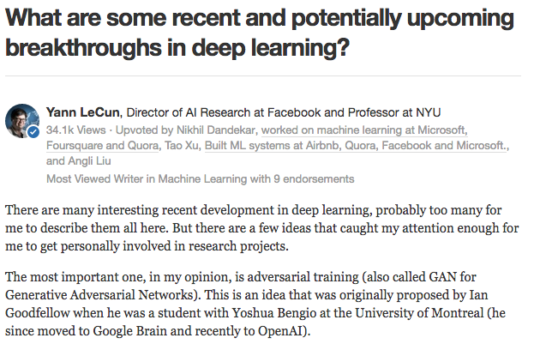
Yann LeCun thinks the GAN idea is pretty neat

Slide 10
The following images are all generated from this method
Many images from the paper, and from the below links: https://github.com/Newmu/dcgan_code http://bamos.github.io/2016/08/09/deep-completion/

Slide 11
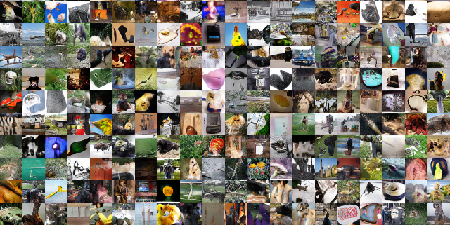
Generated - ImageNet

Slide 12
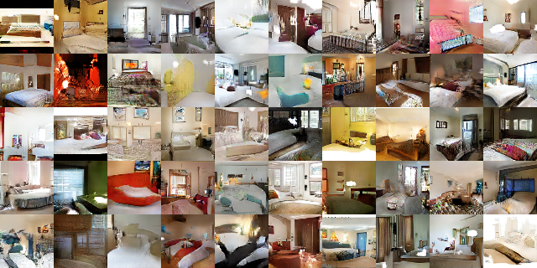
Generated - bedrooms

Slide 13
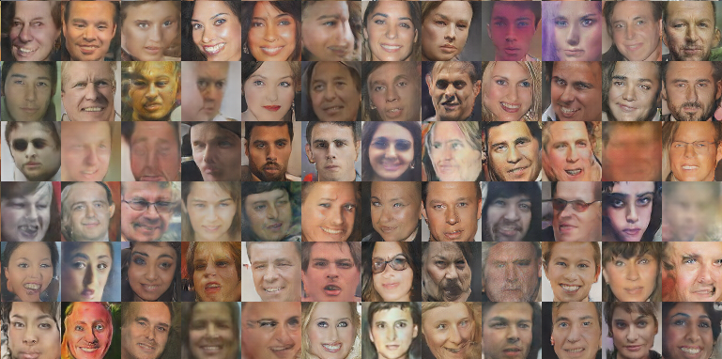
Generated - Faces

Slide 14
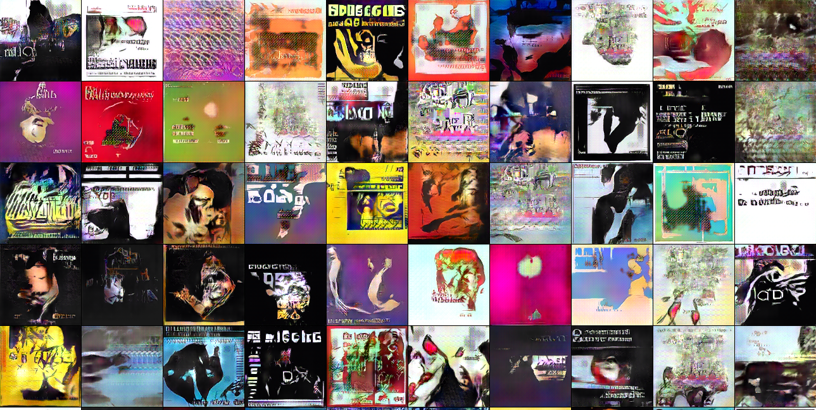
Generated - Albumn Covers

Slide 15
Outline of our chat
Overview of the Deep Convolutional Generative Adversarial Network (DCGAN)
Optimizing a Generative Adversarial Network (GAN)
Specifics of the DCGAN architecture
Generated images and sanity checks that it's not just memorizing examples
Discriminate results for classification using DCGAN

Slide 16
Outline of our chat
Overview of the Deep Convolutional Generative Adversarial Network (DCGAN)
Optimizing a Generative Adversarial Network (GAN)
Specifics of the DCGAN architecture
Generated images and sanity checks that it's not just memorizing examples
Discriminate results for classification using DCGAN

Slide 17
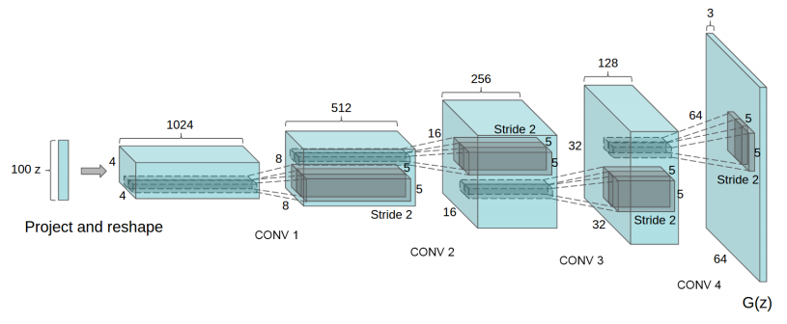
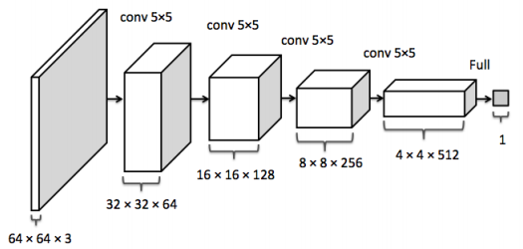
The Deep Convolutional Generative Adversarial Network
Can be thought of as two separate networks

Slide 18
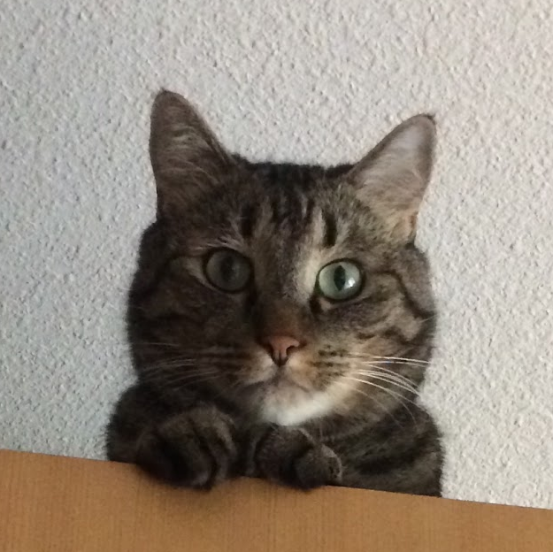
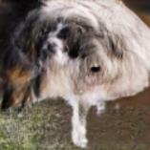
Generator
Discriminator

Slide 19
Generator G(.)
input=random numbers, output=generated image
Uniform noise vector (random numbers)
Generated image G(z)

Slide 20
In this work, they sample
z = a 100-dimensional vector from a uniform distribution ...
Generator G(.)
input=random numbers, output=generated image
# for 5 dimensions
z = np.random.uniform(-1, 1, 5)
array([ 0.77356483, 0.95258473, -0.18345086, 0.69224724, -0.34718733])
http://bamos.github.io/2016/08/09/deep-completion/
We interpret z as the distribution that creates new images
Uniform noise vector (random numbers)
Generated image G(z)

Slide 21
Generator G(.)
input=random numbers, output=generated image
Discriminator D(.)
input=generated/real image,
output=prediction of real image
Uniform noise vector (random numbers)
Generated image G(z)

Slide 22
Real image, so goal is D(x)=1
Generator G(.)
input=random numbers, output=generated image
Discriminator D(.)
input=generated/real image,
output=prediction of real image
Uniform noise vector (random numbers)
Generated image G(z)
Discriminator Goal: discriminate between real and generated images
i.e., D(x)=1, where x is a real image
D(G(z))=0, where G(z) is a generated image
Generated image, so goal is D(G(z))=0

Slide 23
Real image, so goal is D(x)=1
Generator G(.)
input=random numbers, output=generated image
Discriminator D(.)
input=generated/real image,
output=prediction of real image
Uniform noise vector (random numbers)
Generated image G(z)
Generator Goal: Fool D(G(z)) i.e., generate an image G(z) such that D(G(z)) is wrong. i.e., D(G(z)) = 1
Discriminator Goal: discriminate between real and generated images
i.e., D(x)=1, where x is a real image
D(G(z))=0, where G(z) is a generated image
Generated image, so goal is D(G(z))=0

Slide 24
Real image, so goal is D(x)=1
Generator G(.)
input=random numbers, output=generated image
Discriminator D(.)
input=generated/real image,
output=prediction of real image
***Notes***
0. Conflicting goals
1.Both goals are unsupervised
2. Optimal when D(.)=0.5 (i.e., cannot tell the difference between real and generated images) and G(z)=learns the training images distribution
Uniform noise vector (random numbers)
Generated image G(z)
Generator Goal: Fool D(G(z)) i.e., generate an image G(z) such that D(G(z)) is wrong. i.e., D(G(z)) = 1
Discriminator Goal: discriminate between real and generated images
i.e., D(x)=1, where x is a real image
D(G(z))=0, where G(z) is a generated image
Generated image, so goal is D(G(z))=0

Slide 25
We'll jump to this paper to better understand the optimization
Goodfellow, I., Pouget-Abadie, J., Mirza, M., Xu, B., Warde-Farley, D., Ozair, S., … Bengio, Y. (2014). Generative Adversarial Nets. Advances in Neural Information Processing Systems, 2672–2680.

Slide 26
Outline of our chat
Overview of the Deep Convolutional Generative Adversarial Network (DCGAN)
Optimizing a Generative Adversarial Network (GAN)
Specifics of the DCGAN architecture
Generated images and sanity checks that it's not just memorizing examples
Discriminate results for classification using DCGAN

Slide 27
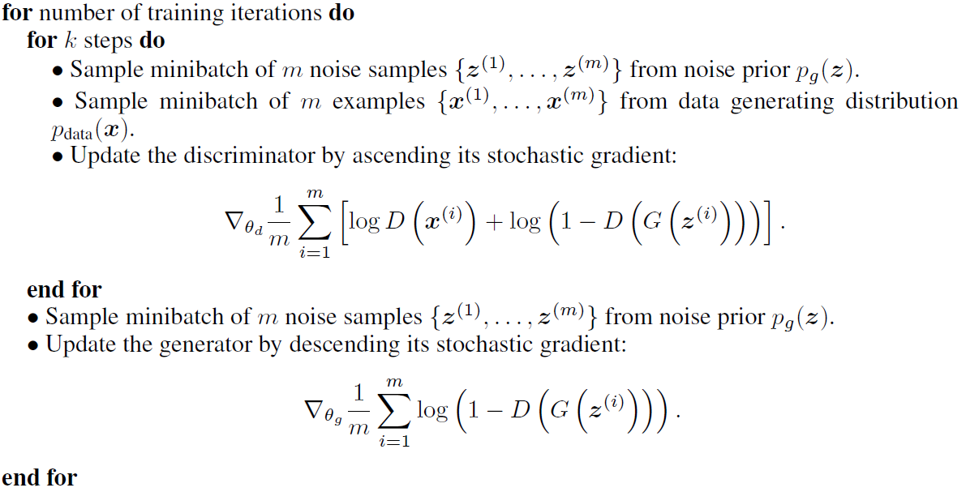

Slide 28
maximize
Loss function to maximize for the Discriminator
minimize
Loss function to minimize for the Generator

Slide 29
maximize
Loss function to maximize for the Discriminator
Gradient w.r.t the parameters of the Discriminator
minimize
Loss function to minimize for the Generator
Gradient w.r.t the parameters of the Generator

Slide 30
[interpretation] compute the gradient of the loss function, and then update the parameters to min/max the loss function
(gradient descent/ascent)
maximize
Loss function to maximize for the Discriminator
Gradient w.r.t the parameters of the Discriminator
minimize
Loss function to minimize for the Generator
Gradient w.r.t the parameters of the Generator

Slide 31
Uniform noise vector (random numbers)
Real images
Discriminator: (input=generated/real image,
output=prediction of real image)
Average over m samples
minimize

Slide 32
D(x) = probability that x is a real image
0 = generated image; 1 = real image
Uniform noise vector (random numbers)
Real images
Discriminator: (input=generated/real image,
output=prediction of real image)
minimize

Slide 33
D(x) = probability that x is a real image
0 = generated image; 1 = real image
Uniform noise vector (random numbers)
Real images
Generator:
input=random numbers, output=synthetic image
Discriminator: (input=generated/real image,
output=prediction of real image)
minimize

Slide 34
D(x) = probability that x is a real image
0 = generated image; 1 = real image
Uniform noise vector (random numbers)
Real images
Generator:
input=random numbers, output=synthetic image
Discriminator: (input=generated/real image,
output=prediction of real image)
Real image
Generated image
minimize

Slide 35
D(x) = probability that x is a real image
0 = generated image; 1 = real image
Uniform noise vector (random numbers)
Real images
Generator:
input=random numbers, output=synthetic image
Gradient w.r.t the parameters of the Discriminator
Discriminator: (input=generated/real image,
output=prediction of real image)
Average over m samples
minimize

Slide 36
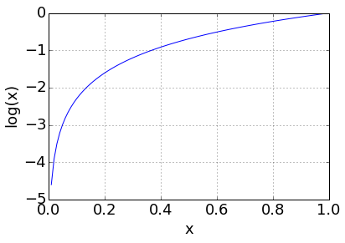
D(x) = probability that x is a real image
0 = generated image; 1 = real image
Uniform noise vector (random numbers)
maximize
Real images
Generator:
input=random numbers, output=synthetic image
Gradient w.r.t the parameters of the Discriminator
Discriminator: (input=generated/real image,
output=prediction of real image)
Average over m samples
Let's do an example
Note showing ln(x) not log(x)
minimize

Slide 37
D(x) = probability that x is a real image
0 = generated image; 1 = real image
Uniform noise vector (random numbers)
maximize
Real images
Generator:
input=random numbers, output=synthetic image
Gradient w.r.t the parameters of the Discriminator
Discriminator: (input=generated/real image,
output=prediction of real image)
Average over m samples
D(x) = 0.8
log(0.8) = -0.2
D(G(z)) = 0.2
log(1-0.2) = log(0.8) = -0.2
-0.2 + -0.2 = -0.4
D(x) = 0.2
log(0.2) = -1.6
D(G(z)) = 0.8
log(1-0.8) = log(0.2) = -1.6
-1.6 + -1.6 = -3.2
Note showing ln(x) not log(x)
Imagine for a real image D(x) scores 0.8 that it is a real image (good)
minimize

Slide 38
D(x) = probability that x is a real image
0 = generated image; 1 = real image
Uniform noise vector (random numbers)
maximize
Real images
Generator:
input=random numbers, output=synthetic image
Gradient w.r.t the parameters of the Discriminator
Discriminator: (input=generated/real image,
output=prediction of real image)
Average over m samples
D(x) = 0.8
log(0.8) = -0.2
D(G(z)) = 0.2
log(1-0.2) = log(0.8) = -0.2
-0.2 + -0.2 = -0.4
D(x) = 0.2
log(0.2) = -1.6
D(G(z)) = 0.8
log(1-0.8) = log(0.2) = -1.6
-1.6 + -1.6 = -3.2
Then for a generated image, D(x) scores 0.2 that it is a real image (good)
Note showing ln(x) not log(x)
minimize

Slide 39
D(x) = probability that x is a real image
0 = generated image; 1 = real image
Uniform noise vector (random numbers)
maximize
Real images
Generator:
input=random numbers, output=synthetic image
Gradient w.r.t the parameters of the Discriminator
Discriminator: (input=generated/real image,
output=prediction of real image)
Average over m samples
D(x) = 0.8
log(0.8) = -0.2
D(G(z)) = 0.2
log(1-0.2) = log(0.8) = -0.2
-0.2 + -0.2 = -0.4
D(x) = 0.2
log(0.2) = -1.6
D(G(z)) = 0.8
log(1-0.8) = log(0.2) = -1.6
-1.6 + -1.6 = -3.2
Note showing ln(x) not log(x)
We add them together and this gives us a fairly high (-0.4) loss (note we ascend so we want to maximize this).
Also note that we are adding two negative numbers so 0 is the upper bound
minimize

Slide 40
D(x) = probability that x is a real image
0 = generated image; 1 = real image
Uniform noise vector (random numbers)
maximize
Real images
Generator:
input=random numbers, output=synthetic image
Gradient w.r.t the parameters of the Discriminator
Discriminator: (input=generated/real image,
output=prediction of real image)
Average over m samples
D(x) = 0.8
log(0.8) = -0.2
D(G(z)) = 0.2
log(1-0.2) = log(0.8) = -0.2
-0.2 + -0.2 = -0.4
D(x) = 0.2
log(0.2) = -1.6
D(G(z)) = 0.8
log(1-0.8) = log(0.2) = -1.6
-1.6 + -1.6 = -3.2
Note showing ln(x) not log(x)
Let's do another example
minimize

Slide 41
D(x) = probability that x is a real image
0 = generated image; 1 = real image
Uniform noise vector (random numbers)
maximize
Real images
Generator:
input=random numbers, output=synthetic image
Gradient w.r.t the parameters of the Discriminator
Discriminator: (input=generated/real image,
output=prediction of real image)
Average over m samples
D(x) = 0.8
log(0.8) = -0.2
D(G(z)) = 0.2
log(1-0.2) = log(0.8) = -0.2
-0.2 + -0.2 = -0.4
D(x) = 0.2
log(0.2) = -1.6
D(G(z)) = 0.8
log(1-0.8) = log(0.2) = -1.6
-1.6 + -1.6 = -3.2
Note showing ln(x) not log(x)
minimize
D(x) scores 0.2 that a real image is a real image (bad)

Slide 42
D(x) = probability that x is a real image
0 = generated image; 1 = real image
Uniform noise vector (random numbers)
maximize
Real images
Generator:
input=random numbers, output=synthetic image
Gradient w.r.t the parameters of the Discriminator
Discriminator: (input=generated/real image,
output=prediction of real image)
Average over m samples
D(x) = 0.8
log(0.8) = -0.2
D(G(z)) = 0.2
log(1-0.2) = log(0.8) = -0.2
-0.2 + -0.2 = -0.4
D(x) = 0.2
log(0.2) = -1.6
D(G(z)) = 0.8
log(1-0.8) = log(0.2) = -1.6
-1.6 + -1.6 = -3.2
Note showing ln(x) not log(x)
minimize
D(x) scores 0.8 that the generated image is a real image (bad)

Slide 43
D(x) = probability that x is a real image
0 = generated image; 1 = real image
Uniform noise vector (random numbers)
maximize
Real images
Generator:
input=random numbers, output=synthetic image
Gradient w.r.t the parameters of the Discriminator
Discriminator: (input=generated/real image,
output=prediction of real image)
Average over m samples
D(x) = 0.8
log(0.8) = -0.2
D(G(z)) = 0.2
log(1-0.2) = log(0.8) = -0.2
-0.2 + -0.2 = -0.4
D(x) = 0.2
log(0.2) = -1.6
D(G(z)) = 0.8
log(1-0.8) = log(0.2) = -1.6
-1.6 + -1.6 = -3.2
Note showing ln(x) not log(x)
These "bad" predictions combined gives a loss of -3.2
minimize

Slide 44
D(x) = probability that x is a real image
0 = generated image; 1 = real image
Uniform noise vector (random numbers)
maximize
Real images
Generator:
input=random numbers, output=synthetic image
Gradient w.r.t the parameters of the Discriminator
Discriminator: (input=generated/real image,
output=prediction of real image)
Average over m samples
D(x) = 0.8
log(0.8) = -0.2
D(G(z)) = 0.2
log(1-0.2) = log(0.8) = -0.2
-0.2 + -0.2 = -0.4
D(x) = 0.2
log(0.2) = -1.6
D(G(z)) = 0.8
log(1-0.8) = log(0.2) = -1.6
-1.6 + -1.6 = -3.2
Note showing ln(x) not log(x)
Compare the loss to when we had "good" predictions
(remember we are maximizing)
minimize

Slide 45
D(x) = probability that x is a real image
0 = generated image; 1 = real image
Uniform noise vector (random numbers)
maximize
Real images
Generator:
input=random numbers, output=synthetic image
Gradient w.r.t the parameters of the Discriminator
Discriminator: (input=generated/real image,
output=prediction of real image)
Average over m samples
Note showing ln(x) not log(x)
minimize

Slide 46
D(x) = probability that x is a real image
0 = generated image; 1 = real image
Uniform noise vector (random numbers)
maximize
Real images
Generator:
input=random numbers, output=synthetic image
Gradient w.r.t the parameters of the Discriminator
Discriminator: (input=generated/real image,
output=prediction of real image)
Average over m samples
Note showing ln(x) not log(x)

Slide 47
D(x) = probability that x is a real image
0 = generated image; 1 = real image
Uniform noise vector (random numbers)
maximize
Real images
Generator:
input=random numbers, output=synthetic image
Gradient w.r.t the parameters of the Discriminator
Discriminator: (input=generated/real image,
output=prediction of real image)
Average over m samples
Note showing ln(x) not log(x)
D(G(z)) = 0.2
log(1-0.2) = log(0.8) = -0.2
D(G(z)) scores 0.2 that a generated image is a real image = bad :( We didn't fooled D(.)

Slide 48
D(x) = probability that x is a real image
0 = generated image; 1 = real image
Uniform noise vector (random numbers)
maximize
Real images
Generator:
input=random numbers, output=synthetic image
Gradient w.r.t the parameters of the Discriminator
Discriminator: (input=generated/real image,
output=prediction of real image)
Average over m samples
Note showing ln(x) not log(x)
D(G(z)) = 0.2
log(1-0.2) = log(0.8) = -0.2
Gets assigned a loss of -0.2

Slide 49
D(x) = probability that x is a real image
0 = generated image; 1 = real image
Uniform noise vector (random numbers)
maximize
Real images
Generator:
input=random numbers, output=synthetic image
Gradient w.r.t the parameters of the Discriminator
Discriminator: (input=generated/real image,
output=prediction of real image)
Average over m samples
Note showing ln(x) not log(x)
D(G(z)) = 0.2
log(1-0.2) = log(0.8) = -0.2
minimize
Notice here we want to minimize this loss function (not maximize like before)

Slide 50
D(x) = probability that x is a real image
0 = generated image; 1 = real image
Uniform noise vector (random numbers)
maximize
Real images
Generator:
input=random numbers, output=synthetic image
Gradient w.r.t the parameters of the Discriminator
Discriminator: (input=generated/real image,
output=prediction of real image)
Average over m samples
Note showing ln(x) not log(x)
D(G(z)) = 0.2
log(1-0.2) = log(0.8) = -0.2
minimize
One more example ...

Slide 51
D(x) = probability that x is a real image
0 = generated image; 1 = real image
Uniform noise vector (random numbers)
maximize
Real images
Generator:
input=random numbers, output=synthetic image
Gradient w.r.t the parameters of the Discriminator
Discriminator: (input=generated/real image,
output=prediction of real image)
Average over m samples
Note showing ln(x) not log(x)
D(G(z)) = 0.2
log(1-0.2) = log(0.8) = -0.2
minimize
D(G(z)) = 0.8
log(1-0.8) = log(0.2) = -1.6
D(G(z)) scores 0.8 that a generated image is a real image = good :) We fooled D(.)!

Slide 52
D(x) = probability that x is a real image
0 = generated image; 1 = real image
Uniform noise vector (random numbers)
maximize
Real images
Generator:
input=random numbers, output=synthetic image
Gradient w.r.t the parameters of the Discriminator
Discriminator: (input=generated/real image,
output=prediction of real image)
Average over m samples
Note showing ln(x) not log(x)
D(G(z)) = 0.2
log(1-0.2) = log(0.8) = -0.2
minimize
D(G(z)) = 0.8
log(1-0.8) = log(0.2) = -1.6
This gives loss of -1.6

Slide 53
D(x) = probability that x is a real image
0 = generated image; 1 = real image
Uniform noise vector (random numbers)
maximize
Real images
Generator:
input=random numbers, output=synthetic image
Gradient w.r.t the parameters of the Discriminator
Discriminator: (input=generated/real image,
output=prediction of real image)
Average over m samples
Note showing ln(x) not log(x)
D(G(z)) = 0.2
log(1-0.2) = log(0.8) = -0.2
minimize
D(G(z)) = 0.8
log(1-0.8) = log(0.2) = -1.6
So minimizing this loss
means to generate images that fool D(.)

Slide 54
D(x) = probability that x is a real image
0 = generated image; 1 = real image
Uniform noise vector (random numbers)
maximize
Real images
Generator:
input=random numbers, output=synthetic image
Gradient w.r.t the parameters of the Discriminator
Discriminator: (input=generated/real image,
output=prediction of real image)
Average over m samples
Note showing ln(x) not log(x)
minimize
Gradient w.r.t the parameters of the Generator

Slide 55
Outline of our chat
Overview of the Deep Convolutional Generative Adversarial Network (DCGAN)
Optimizing a Generative Adversarial Network (GAN)
Specifics of the DCGAN architecture
Generated images and sanity checks that it's not just memorizing examples
Discriminate results for classification using DCGAN

Slide 56
The Deep Convolutional Generative Adversarial Network
Let's explore some of the interesting architecture aspects of this architecture

Slide 57
Generator
Uniform noise vector (random numbers)

Slide 58
Generator
Uniform noise vector (random numbers)
Fully-connected layer (composed of weights) reshaped to have width, height and feature maps

Slide 59
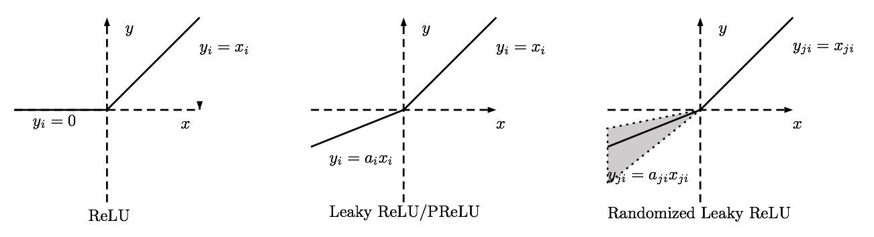
Generator
Uses ReLU activation functions
Uniform noise vector (random numbers)
Fully-connected layer (composed of weights) reshaped to have width, height and feature maps

Slide 60
Generator
Uses ReLU activation functions
Uniform noise vector (random numbers)
Fully-connected layer (composed of weights) reshaped to have width, height and feature maps
Batch Normalization: normalize responses to have zero mean and unit variance over the entire mini-batch
*critical - and used in a lot of other works*

Slide 61
Generator
Uses Tanh to scale generated image output between -1 and 1
Uses ReLU activation functions
Uniform noise vector (random numbers)
Fully-connected layer (composed of weights) reshaped to have width, height and feature maps
Batch Normalization: normalize responses to have zero mean and unit variance over the entire mini-batch
*critical - and used in a lot of other works*

Slide 62
Generator
Fractionally-strided convolutions.
8x8 input, 5x5 conv window = 16x16 output
Uses Tanh to scale generated image output between -1 and 1
Uses ReLU activation functions
Uniform noise vector (random numbers)
Fully-connected layer (composed of weights) reshaped to have width, height and feature maps
Batch Normalization: normalize responses to have zero mean and unit variance over the entire mini-batch
*critical - and used in a lot of other works*

Slide 63

Regular convolutions
Output = 3x3
Filter size=3x3
Clear dashed squares = zero-padded inputs
Input = 5x5
with zero-padding at border = 6x6
(stride=2)
https://github.com/vdumoulin/conv_arithmetic

Slide 64

Note: not 100% sure about this. See :
http://datascience.stackexchange.com/questions/6107/what-are-deconvolutional-layers
https://www.reddit.com/r/MachineLearning/comments/4bbod7/which_deep_learning_frameworks_support_fractional/
Regular convolutions
Fractionally-strided convolutions
Output = 3x3
Output = 5x5
Filter size=3x3
Clear dashed squares = zero-padded inputs
Input = 5x5
with zero-padding at border = 6x6
(stride=2)
Input = 3x3
Interlace zero-padding with inputs = 7x7
(stride=2)
https://github.com/vdumoulin/conv_arithmetic

Slide 65
Generator
Fractionally-strided convolutions.
8x8 input, 5x5 conv window = 16x16 output (padding is done to get dims to work)
Uses Tanh to scale generated image output between -1 and 1
Uses ReLU activation functions
Uniform noise vector (random numbers)
Fully-connected layer (composed of weights) reshaped to have width, height and feature maps
Batch Normalization: normalize responses to have zero mean and unit variance over the entire mini-batch
*critical - and used in a lot of other works*

Slide 66
The Deep Convolutional Generative Adversarial Network

Slide 67
Discriminator
Goal: discriminate between real and generated images
i.e., D(x)=1, if x is a real image
D(G(z))=0, if G(z) is a generated image
Real image
Generated
Image from: Yeh, R., Chen, C., Lim, T. Y., Hasegawa-Johnson, M., & Do, M. N. (2016). Semantic Image Inpainting with Perceptual and Contextual Losses.

Slide 68
Discriminator
Goal: discriminate between real and generated images
i.e., D(x)=1, if x is a real image
D(G(z))=0, if G(z) is a generated image
Real image
Sigmoid (between 0-1)
Generated
Batch Normalization
Image from: Yeh, R., Chen, C., Lim, T. Y., Hasegawa-Johnson, M., & Do, M. N. (2016). Semantic Image Inpainting with Perceptual and Contextual Losses.

Slide 69
Discriminator
Goal: discriminate between real and generated images
i.e., D(x)=1, if x is a real image
D(G(z))=0, if G(z) is a generated image
Real image
Uses LeakyReLU activation functions
Sigmoid (between 0-1)
Generated
Batch Normalization
Image from: Yeh, R., Chen, C., Lim, T. Y., Hasegawa-Johnson, M., & Do, M. N. (2016). Semantic Image Inpainting with Perceptual and Contextual Losses.

Slide 70
Discriminator
Goal: discriminate between real and generated images
i.e., D(x)=1, if x is a real image
D(G(z))=0, if G(z) is a generated image
Real image
Uses LeakyReLU activation functions
Sigmoid (between 0-1)
Generated
\alpha=0.2
Xu, B., Wang, N., Chen, T., & Li, M. (2015). Empirical Evaluation of Rectified Activations in Convolution Network. ICML Deep Learning Workshop, 06–11.
Batch Normalization
Image from: Yeh, R., Chen, C., Lim, T. Y., Hasegawa-Johnson, M., & Do, M. N. (2016). Semantic Image Inpainting with Perceptual and Contextual Losses.

Slide 71
Discriminator
Goal: discriminate between real and generated images
i.e., D(x)=1, if x is a real image
D(G(z))=0, if G(z) is a generated image
Real image
Uses LeakyReLU activation functions
Sigmoid (between 0-1)
Generated
No max pooling!
Reduces spatial dimensionality through strided convolutions
Batch Normalization
Image from: Yeh, R., Chen, C., Lim, T. Y., Hasegawa-Johnson, M., & Do, M. N. (2016). Semantic Image Inpainting with Perceptual and Contextual Losses.

Slide 72
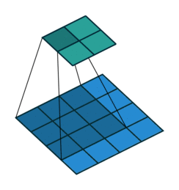
Discriminator
Strides
Goal: discriminate between real and generated images
i.e., D(x)=1, if x is a real image
D(G(z))=0, if G(z) is a generated image
Real image
Uses LeakyReLU activation functions
Sigmoid (between 0-1)
Generated
No max pooling!
Reduces spatial dimensionality through strided convolutions
Input = 4x4
Filter = 3x3
stride=1
output=2x2
Batch Normalization
https://github.com/vdumoulin/conv_arithmetic
Image from: Yeh, R., Chen, C., Lim, T. Y., Hasegawa-Johnson, M., & Do, M. N. (2016). Semantic Image Inpainting with Perceptual and Contextual Losses.

Slide 73

Discriminator
Strides
Goal: discriminate between real and generated images
i.e., D(x)=1, if x is a real image
D(G(z))=0, if G(z) is a generated image
Larger strides reduces dimensionality faster!
Real image
Uses LeakyReLU activation functions
Sigmoid (between 0-1)
Generated
No max pooling!
Reduces spatial dimensionality through strided convolutions
Input = 4x4
Filter = 3x3
stride=1
output=2x2
Input = 5x5
Filter = 3x3
stride=2
output=2x2
Batch Normalization
https://github.com/vdumoulin/conv_arithmetic
Image from: Yeh, R., Chen, C., Lim, T. Y., Hasegawa-Johnson, M., & Do, M. N. (2016). Semantic Image Inpainting with Perceptual and Contextual Losses.

Slide 74
Discriminator
Goal: discriminate between real and generated images
i.e., D(x)=1, if x is a real image
D(G(z))=0, if G(z) is a generated image
Real image
Uses LeakyReLU activation functions
Sigmoid (between 0-1)
Generated
No max pooling!
Reduces spatial dimensionality through strided convolutions
Batch Normalization
Image from: Yeh, R., Chen, C., Lim, T. Y., Hasegawa-Johnson, M., & Do, M. N. (2016). Semantic Image Inpainting with Perceptual and Contextual Losses.

Slide 75
Details
Pre-processing: scale images between -1 and 1 (tanh range)
Mini-batch = 128
Adam optimizer (adaptive moment estimation) = similar to SGD but with less parameter tuning
Weight initializations = zero-centered normal distributions with std. dev. = 0.02
momentum = 0.5 (usually is 0.9 but training oscillated and was unstable)
Low learning rate = 0.0002 (suggested is 0.001)

Slide 76
Outline of our chat
Overview of the Deep Convolutional Generative Adversarial Network (DCGAN)
Optimizing a Generative Adversarial Network (GAN)
Specifics of the DCGAN architecture
Generated images and sanity checks that it's not just memorizing examples
Discriminate results for classification using DCGAN

Slide 77
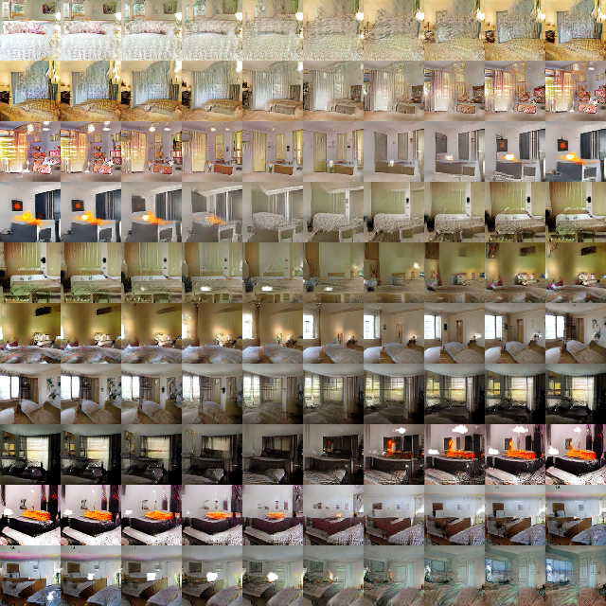
Interpolating between a series of random points in Z
(Z=the 100-d random numbers)
Note the smooth transition between each scene
←the window slowly appearing
This indicates that the space learned has smooth transitions!
(and is not simply memorizing)

Slide 78
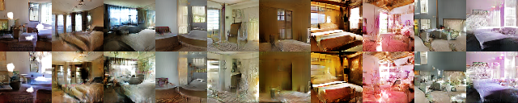
(Top) Unmodified sample generated images
(Bottom) Samples generated after dropping out "window" concept.
Some windows are removed or transformed
The overall scene stays the same, indicating the generator has separated objects (windows) from the scene

Slide 79
How to drop out window filters? Draw bounding boxes over windows. Drop out (set to zero?) the feature maps that are activated on a window. Generate new samples with and without these feature maps removed.
(I'm not entirely clear on the details of how this was done)
(Top) Unmodified sample generated images
(Bottom) Samples generated after dropping out "window" concept.
Some windows are removed or transformed
The overall scene stays the same, indicating the generator has separated objects (windows) from the scene

Slide 80
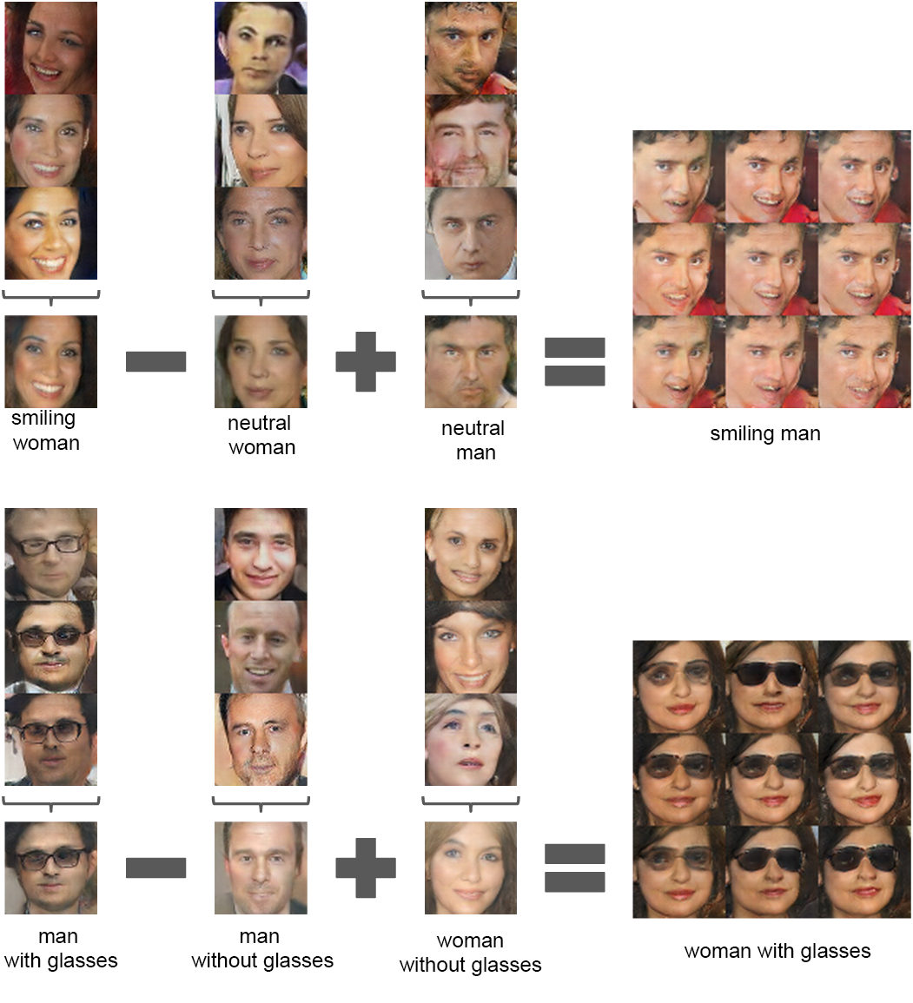
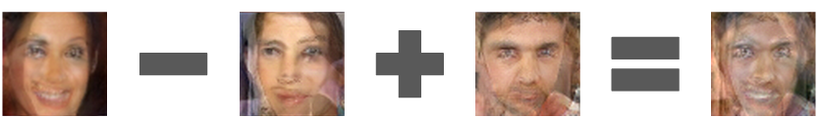
Find 3 exemplar images (e.g., 3 smiling women, 3 neutral women and 3 neutral men)
Other images are added small uniform noise to the new vector!
All similar concepts!
Average their Z vector
Do simple vector arithmetic operations
Generate an image based on this new vector!!!
Arithmetic in pixel space

Slide 81
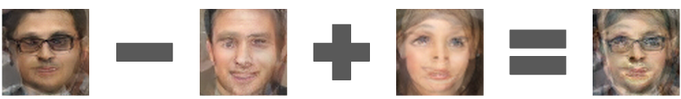
Arithmetic in pixel space

Slide 82
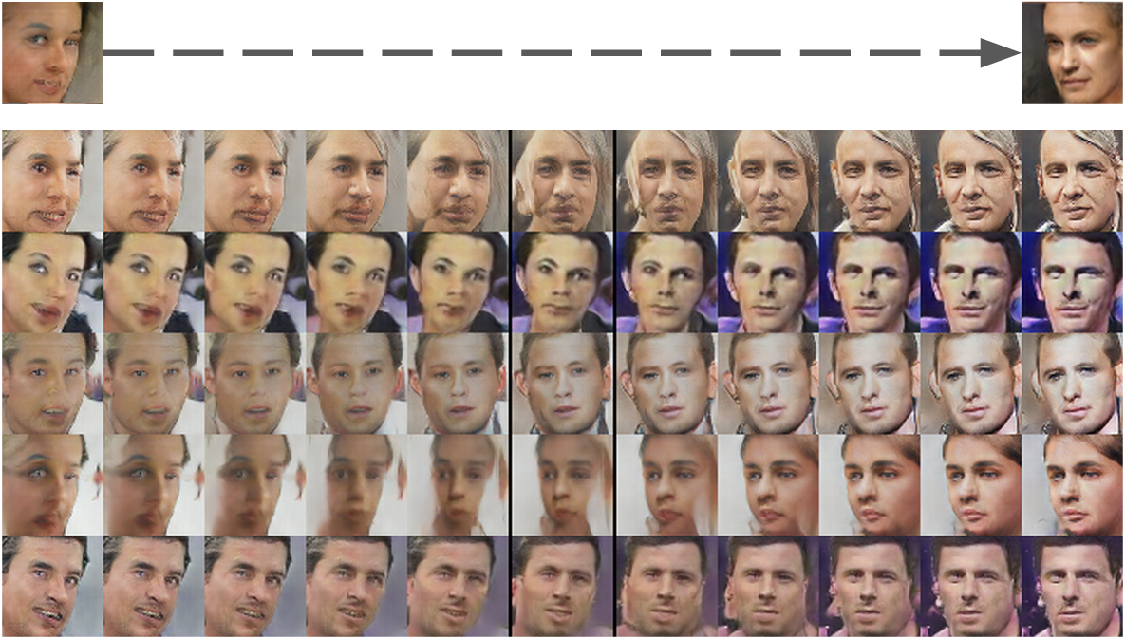
Average 4 vectors from exemplar faces looking left and 4 looking right
Interpolate between the left and right vectors creates a "turn vector"!!!

Slide 83
Amazing generated images… but wait there's more!
The discriminative representations are pretty useful too

Slide 84
Outline of our chat
Overview of the Deep Convolutional Generative Adversarial Network (DCGAN)
Optimizing a Generative Adversarial Network (GAN)
Specifics of the DCGAN architecture
Generated images and sanity checks that it's not just memorizing examples
Discriminate results for classification using DCGAN

Slide 85
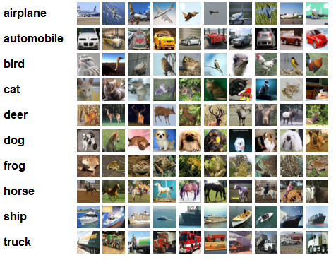
CIFAR-10
http://karpathy.github.io/2011/04/27/manually-classifying-cifar10/

Slide 86
CIFAR-10
1) Train on ImageNet
2) Get all the responses from the Discriminator's layers
3) Max-pool each layer to get a 4x4 spatial grid
4) Flatten to form a 28672 dimensional feature vector
5) Train a regularized linear L2-SVM classifier for CIFAR-10
http://karpathy.github.io/2011/04/27/manually-classifying-cifar10/

Slide 87
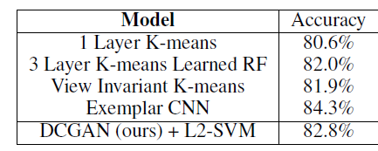
CIFAR-10
1) Train on ImageNet
2) Get all the responses from the Discriminator's layers
3) Max-pool each layer to get a 4x4 spatial grid
4) Flatten to form a 28672 dimensional feature vector
5) Train a regularized linear L2-SVM classifier for CIFAR-10
(note: while other approaches achieve higher performance, this network was not trained on CIFAR-10!)
http://karpathy.github.io/2011/04/27/manually-classifying-cifar10/

Slide 88
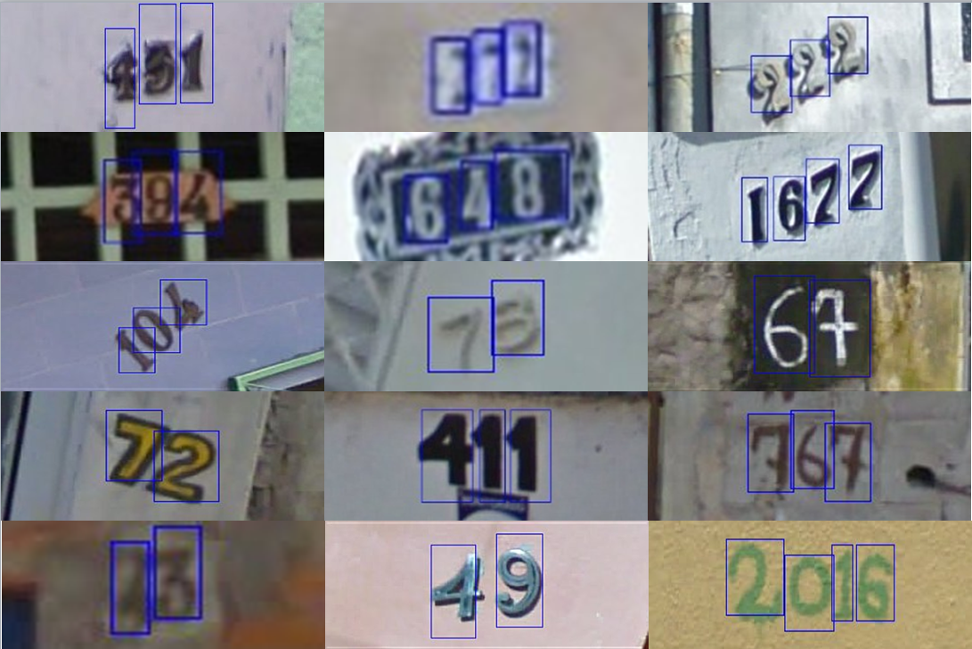
StreetView House Numbers
Similar training procedure as before

Slide 89
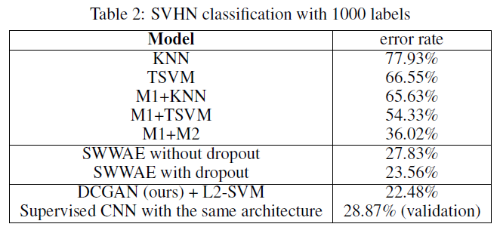
StreetView House Numbers
Similar training procedure as before
State of the art results
Results are not just from the modified architecture. Come from the GAN

Slide 90
Summary
Unsupervised learning that really seems to work!
Visualizations indicate that the Generator is learning something close to the true distribution of real images
Classification performance using the Discriminator features indicates that features learned are discriminative of the underlying classes

Slide 91
eof

